Slide 1







Emotion-Based Music Recommendations
By,
Chathurya Goud Kodipaka
Semester – Fall 2024
Professor – Chaoji Wang

Slide 2

Contents
Introduction
Objectives
Data Overview
Exploratory Data Analysis (EDA)
Model Application
Results
Conclusion
Future Enhancements

Slide 3
Introduction
Developing an emotion-based music recommendation system that detects facial expressions to match users with songs tailored to their current mood.
Offers a personalized music experience that can uplift, calm, or energize, supporting mental well-being and creating immersive, emotion-driven interactions.
Has applications in mental health, entertainment, and user personalization, using music as a tool for mood regulation and enhanced well-being.
Exploring accuracy: How effectively can models classify emotions from images, and what improvements are needed?

Slide 4
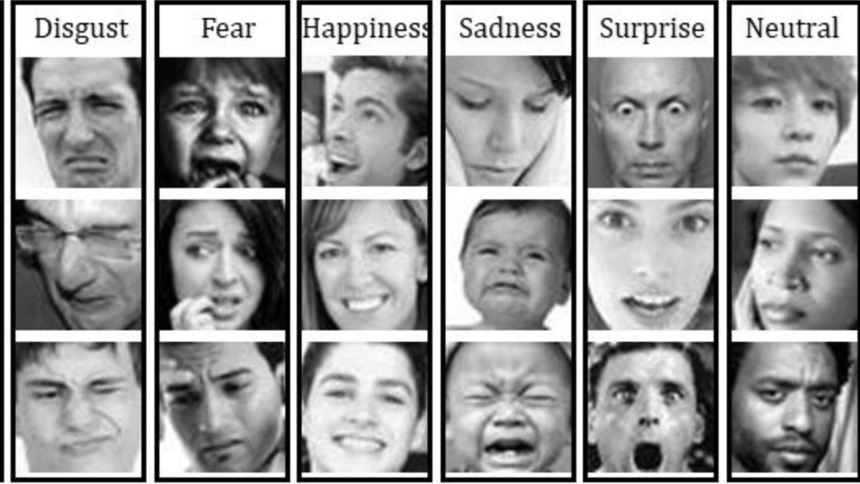
Data Overview
FER 2013 DataSet - FER 2013
The data contains 48x48 grayscale images of faces with 7 emotion labels (Angry, Disgust, Fear, Happy, Sad, Surprise, Neutral).
Total Images: 35,887 (Train: 28,709, Test: 7,178).
Each row represents an image labeled by emotion, used to train models for facial emotion detection.
Data Size: 63 MB

Slide 5


contd..
Spotify Dataset: Spotify Data
Includes 686 songs with audio features and metadata (e.g., name, artist, album, mood).
Mood Categories: Happy, Sad, Energetic, Calm.
Used to match songs with detected emotions from facial images
Data Size: 57 KB.

Slide 6
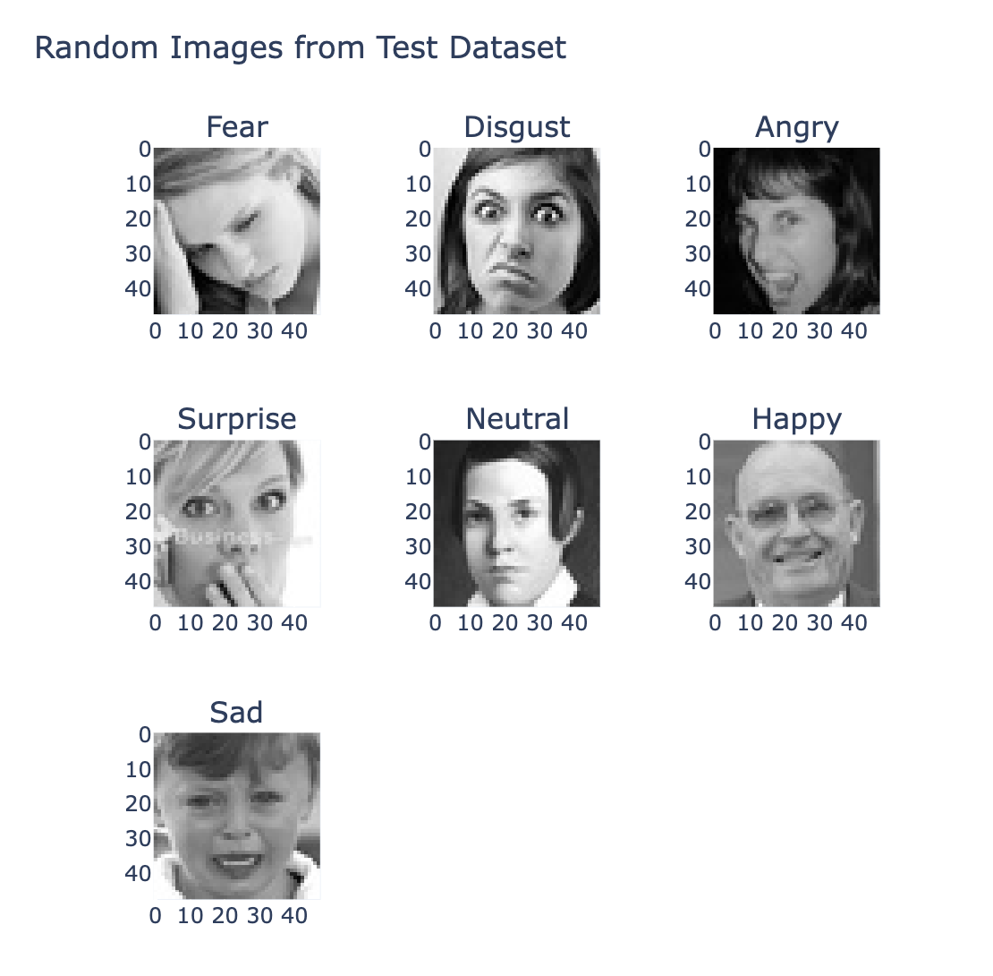
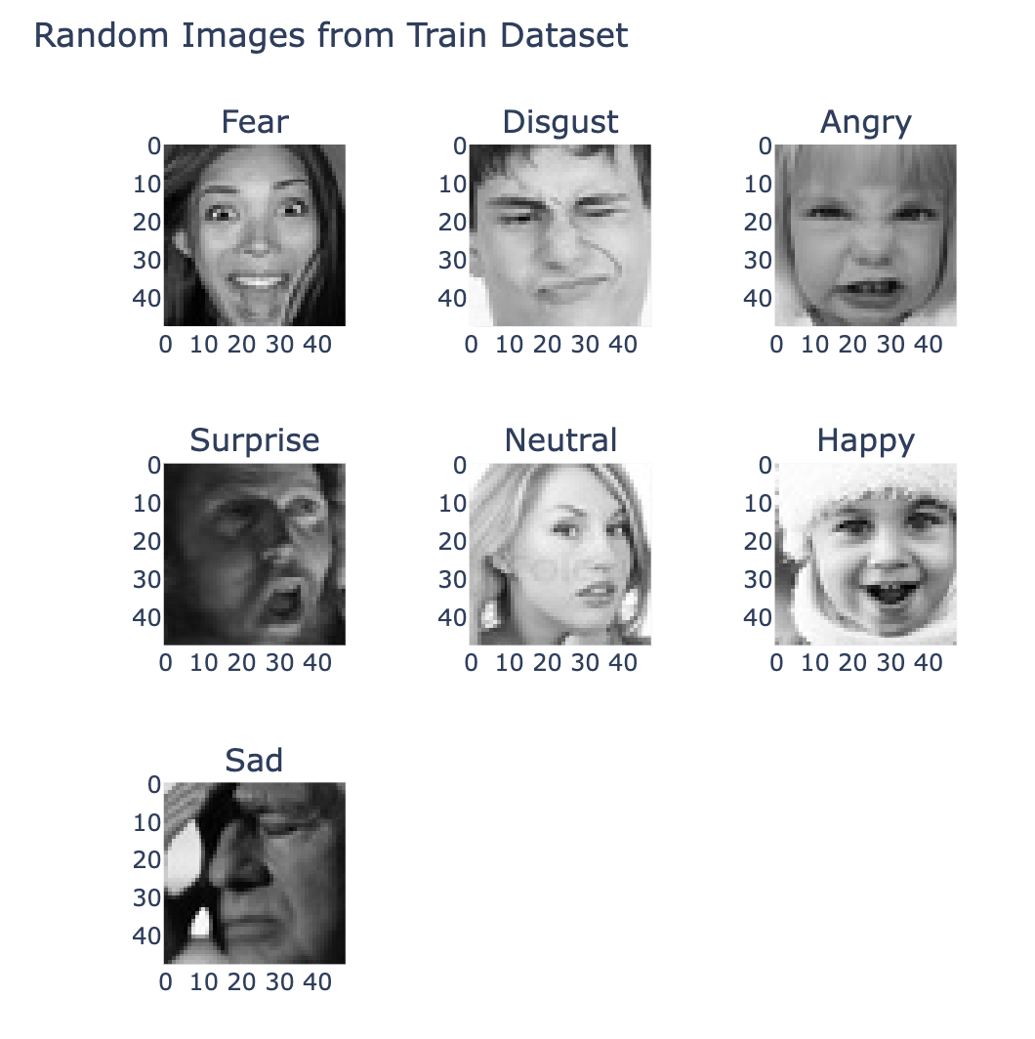
Exploratory Data Analysis (EDA)

Slide 7
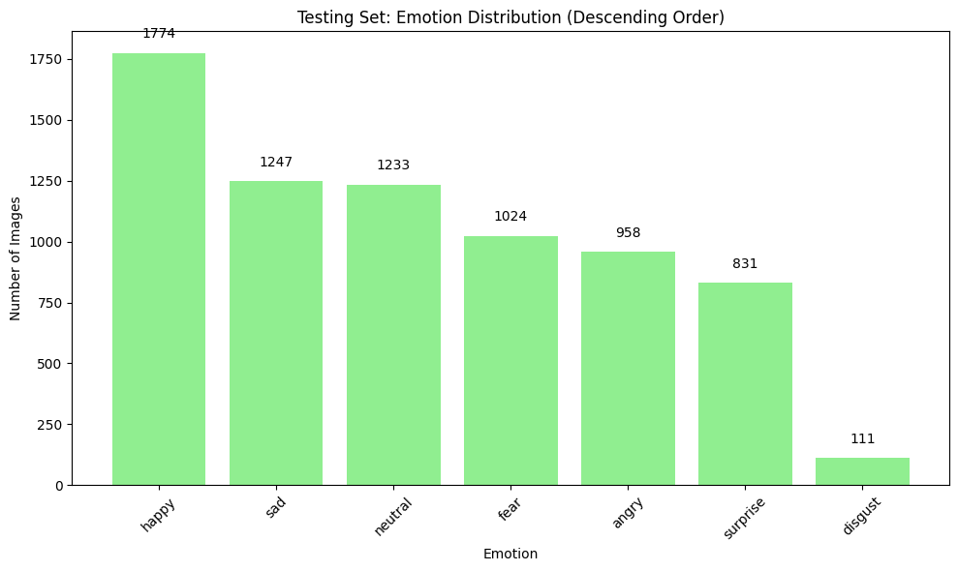
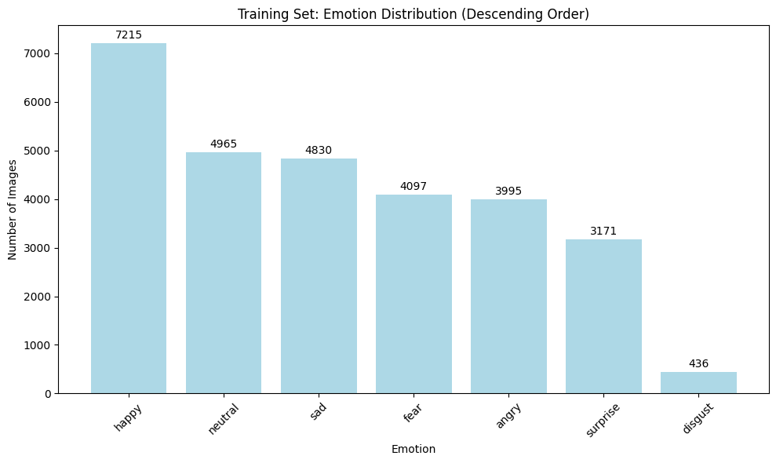
contd..

Slide 8
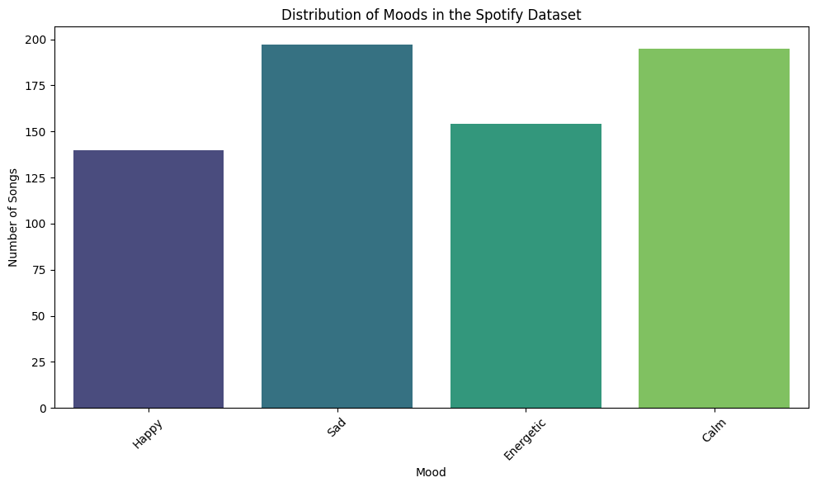
contd..

Slide 9
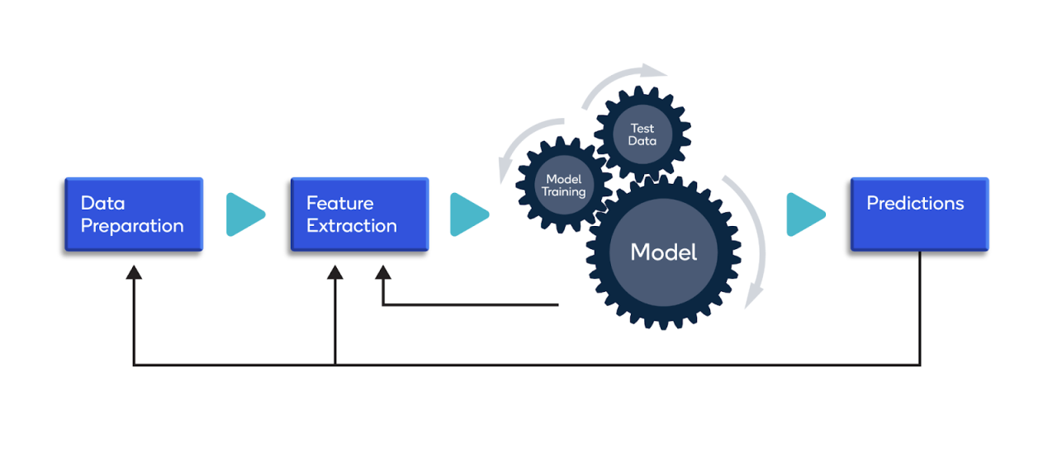
Model Training
Training Approach:
Data Split: 80/20 for training/testing with an additional 20% validation split within training data.
Data Augmentation: Rotation, zoom, width/height shifts, brightness adjustments, and horizontal flips for enhanced generalization.
Transfer Learning: EfficientNetB0 and VGG16 utilize ImageNet pre-trained weights with selective layer fine-tuning.
Models:
Convolutional Neural Network
Efficinet Net B0
VGG 16
ResNET 50 V2

Slide 10
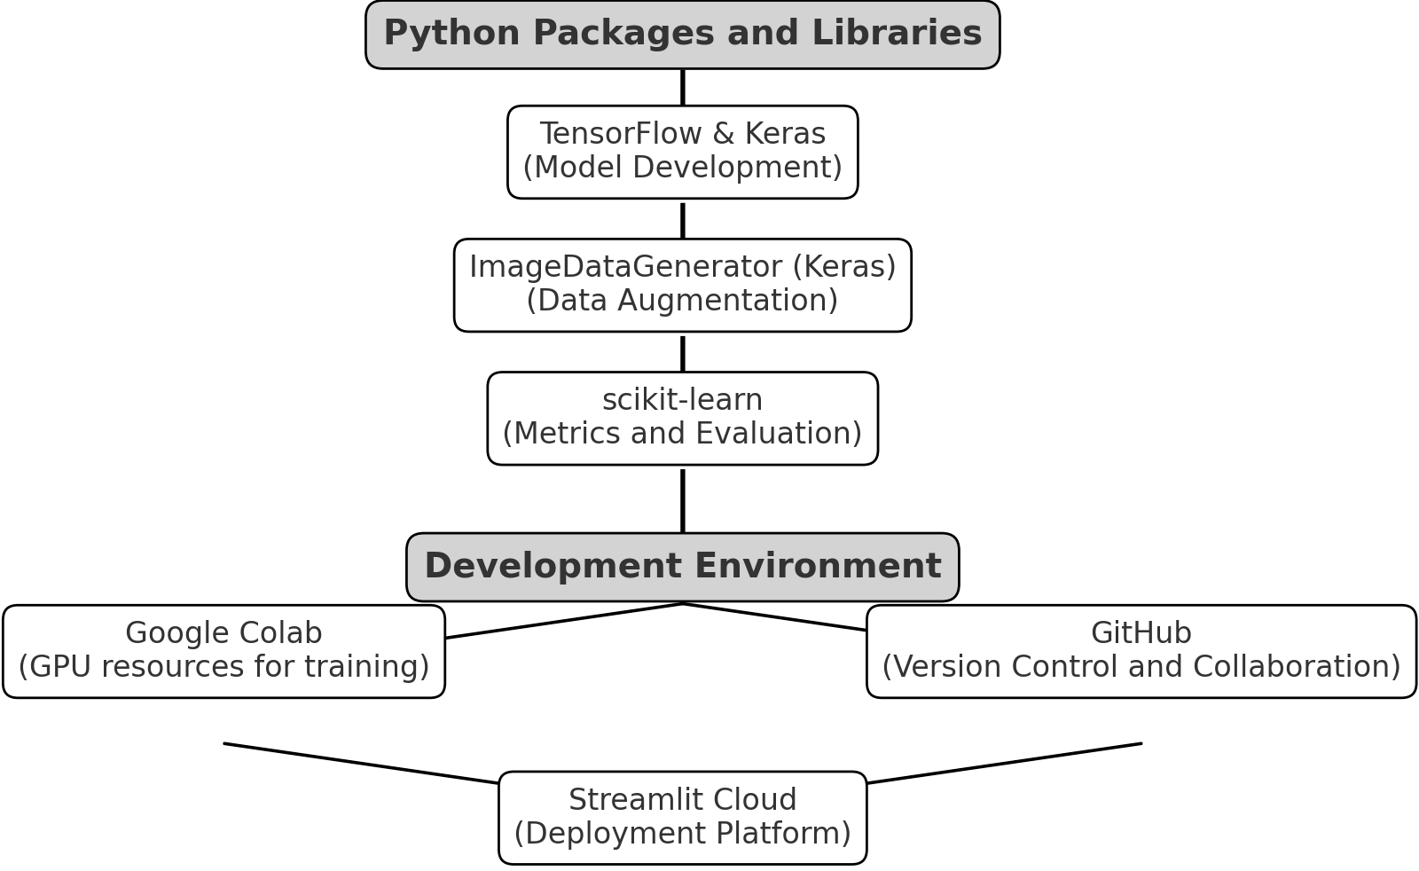
contd..

Slide 11

Conclusion

Slide 12
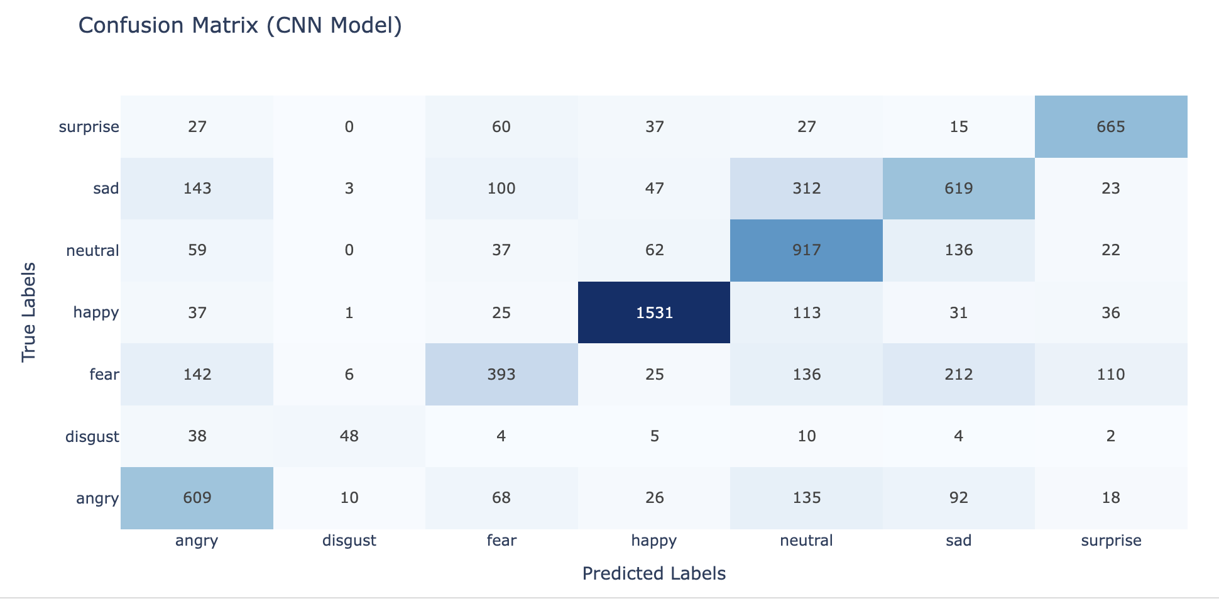
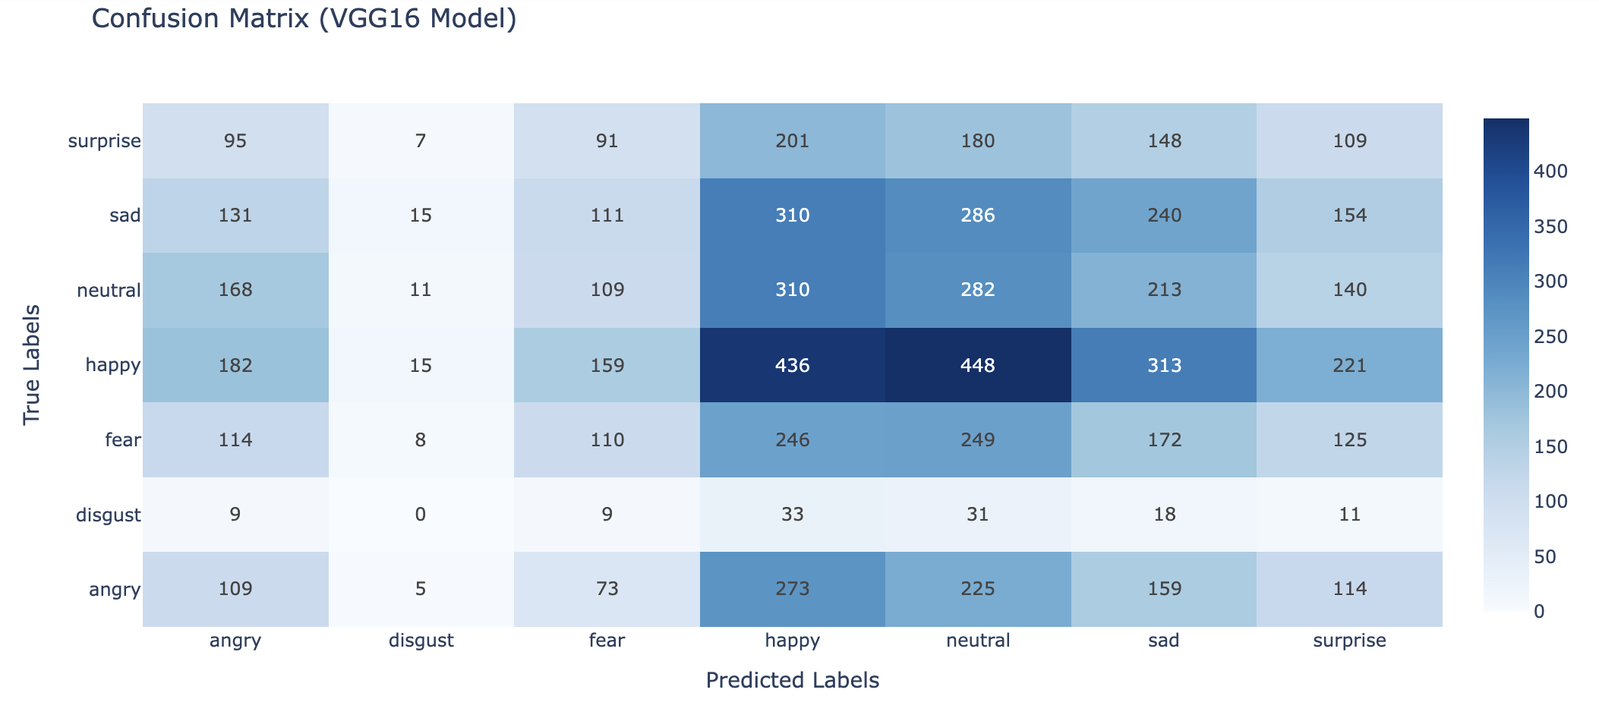

Slide 13
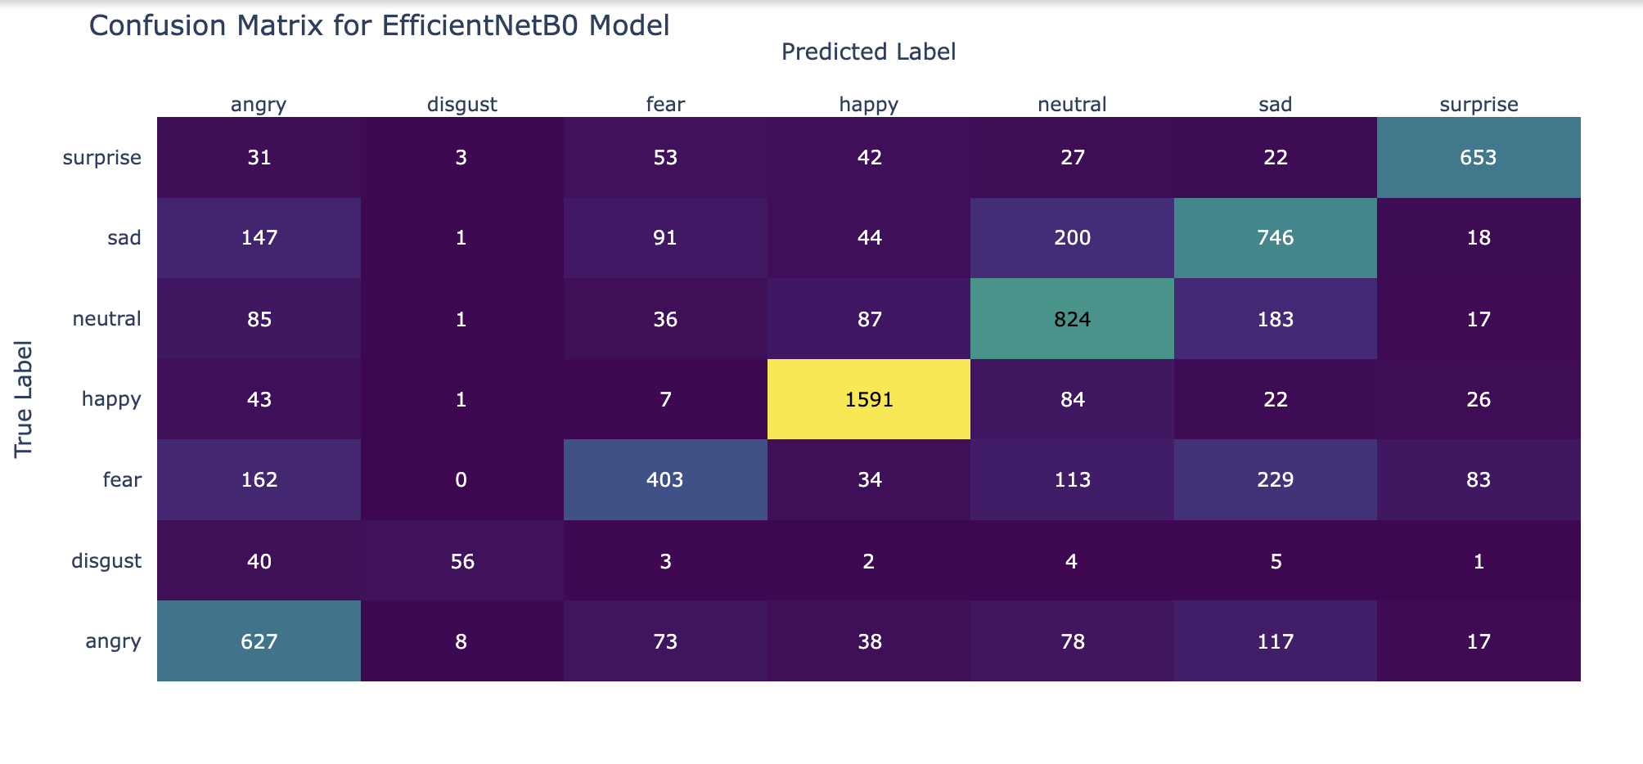
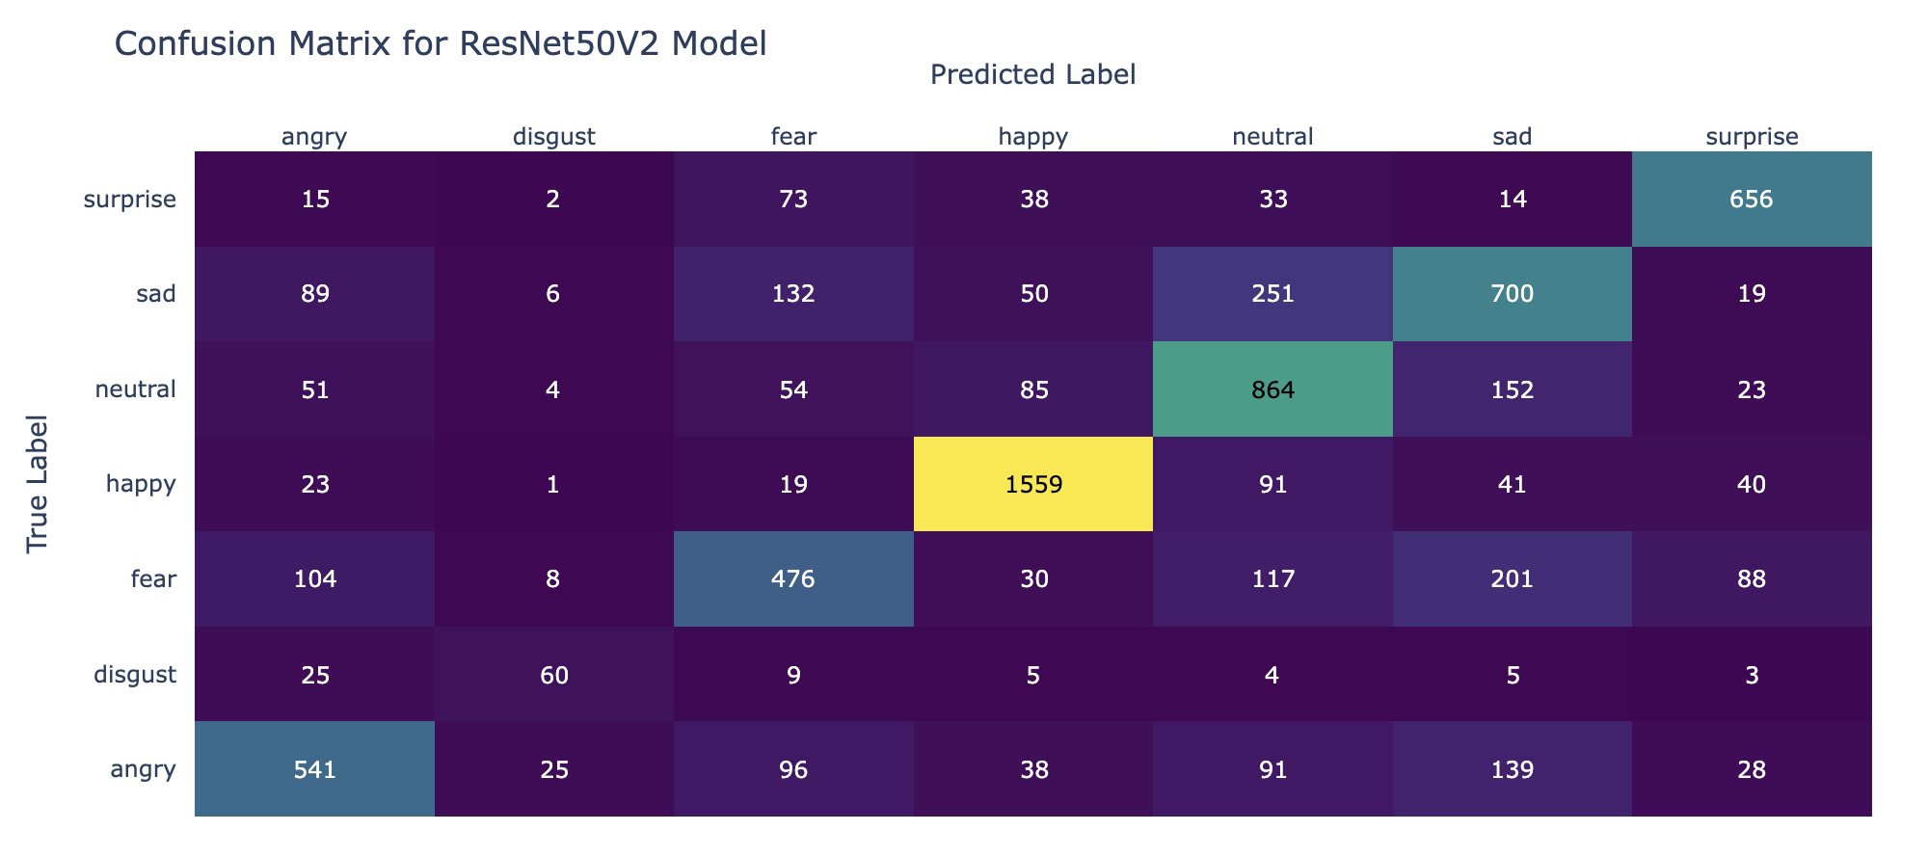

Slide 14

Future Enhancements
Class Imbalance Solutions: Implement oversampling or synthetic data generation for underrepresented emotions (e.g., "disgust").
Additional Augmentation: Experiment with brightness and contrast adjustments, random cropping.
Ensemble Models: Combine predictions from multiple models for improved accuracy.
User Feedback Mechanism: Integrate user feedback on music recommendations to refine the recommendation algorithm.
Performance Optimization: Implement regularization techniques to address overfitting in complex models like EfficientNetB0.

Slide 15
Web App Deployment with Streamlit
App Functionality:
Allows users to upload images for emotion detection.
Recommends songs based on detected emotions.
Deployment Workflow:
Development: Code written in Visual Studio Code.
Version Control: Managed via GitHub.
Deployment: Streamlit Cloud for public accessibility.
Streamlit app - Emotion Detection App

Slide 16


